Slide 1

Test Automation & Advanced Selenium
WebDriver Test with XUnit
GIT&Jenkin
Lesson 06: Introduction to Jenkin

Slide 2
Test Automation & Advanced Selenium
WebDriver Test with XUnit
Add instructor notes
Lesson Objectives
Jenkins Introduction
Creating Configuring and Running Jenkins Jobs
Adding plugin in Jenkins
Creating Job with Maven & Git
here.

Slide 3
Test Automation & Advanced Selenium
WebDriver Test with XUnit
Add instructor notes
Jenkins Introduction
Jenkins
Jenkins is a self-contained, open source automation server which can be used to automate all sorts of tasks such as building, testing, and deploying software.
Jenkins is an open source continuous integration(CI) tool written in java developed by Kohsuke Kawaguchi.
Monitors the change in the source control systems like SVN, CVS, etc.
Builds the application using various build tools like ANT, MAVEN, etc.
Provides a fresh build whenever there is a change in the source control system
Sends messages on the status of the build through Email, SMS, etc
Plugins allows integration of the various DevOps Stage
here.

Slide 4
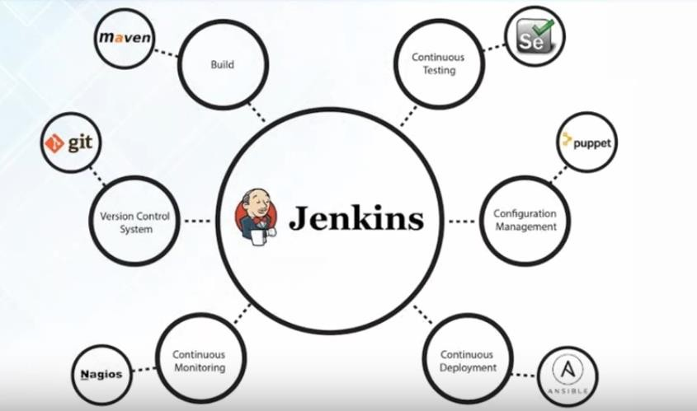
Test Automation & Advanced Selenium
WebDriver Test with XUnit
What different models we can integrate with
Jenkins Introduction
Jenkins
jenkin

Slide 5
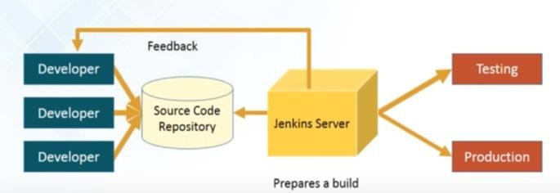
Test Automation & Advanced Selenium
WebDriver Test with XUnit
Add instructor notes
Jenkins Introduction
How Jenkins Works
How Jenkins works:
Developers Commit changes to the source code
CI server pulls that code & triggers a build
The build application is then deployed on testing server for testing
After testing the application ,it is then deployed on production server
The concerned team constantly notified about build & test result
here.

Slide 6
Test Automation & Advanced Selenium
WebDriver Test with XUnit
Add instructor notes
Jenkins Introduction
Jenkins Installation
here.
Jenkins is easy to install.
Download Jenkins.war file from the Jenkins site:
http://jenkins-ci.org
Jenkins can be installed in different ways:
As a standalone application
Windows Service
Deploy it on any application server.

Slide 7
Test Automation & Advanced Selenium
WebDriver Test with XUnit
Jenkins Introduction
Jenkins Installation
To start Jenkins as a standalone application execute the below command in command prompt:
java –jar jenkins.war -- On Port 8080
java -jar jenkins.war --ajp13Port=-1 --httpPort=8082 –On different port
Once Jenkins is started, the Jenkins dash board can be accessed by giving the following link in the browser
http://localhost:8080/
To stop Jenkins, press Ctrl+C
Below are the steps to start Jenkins as a windows service
First, start Jenkins as a standalone application and access Jenkins dash board.
Click “Manage Jenkins” link available in Jenkins dash board.
Select “Installation Directory” for Jenkins and click on Install.
After installation, Jenkins will always run on portno 8080.
By default, Jenkins will run on the 8080 port. To specify the port manually, use the -
-httpPort option:
java -jar jenkins.war --httpPort=8081

Slide 8
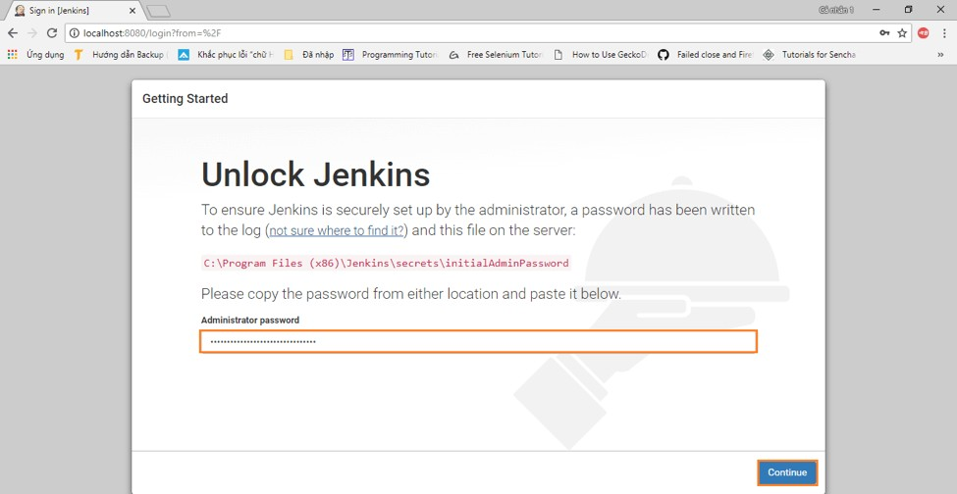
Test Automation & Advanced Selenium
WebDriver Test with XUnit
Unlock Jenkins

Slide 9
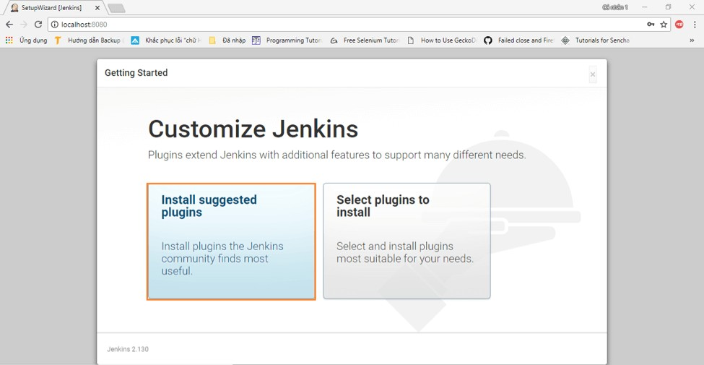
Test Automation & Advanced Selenium
WebDriver Test with XUnit
Customize Jenkins

Slide 10
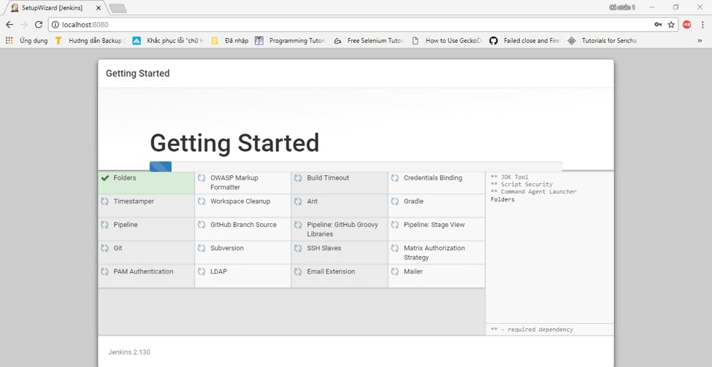
Test Automation & Advanced Selenium
WebDriver Test with XUnit
Install Plugins

Slide 11
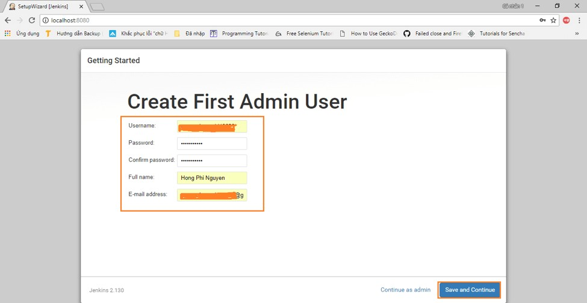
Test Automation & Advanced Selenium
WebDriver Test with XUnit
Create Admin User

Slide 12
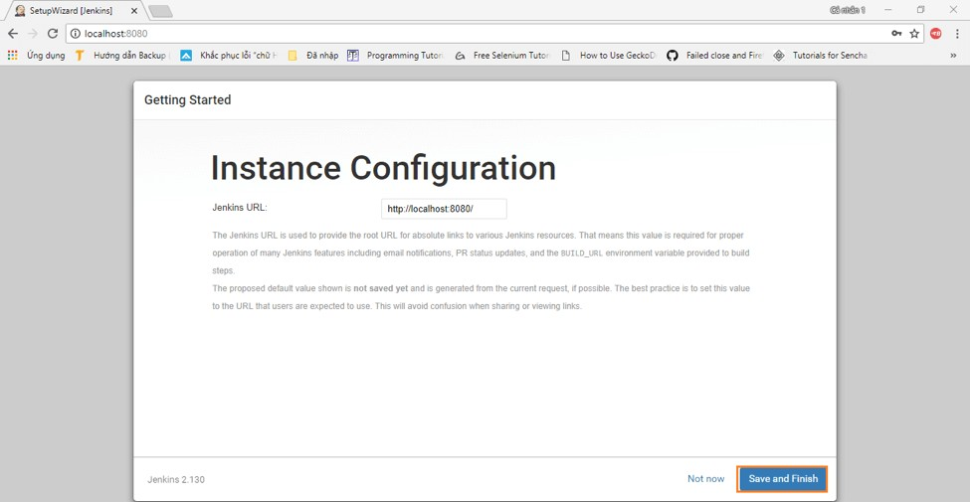
Test Automation & Advanced Selenium
WebDriver Test with XUnit
Instance Configuration

Slide 13
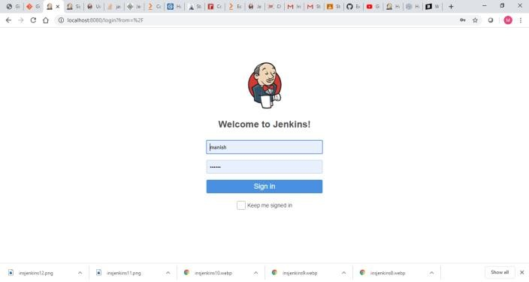
Test Automation & Advanced Selenium
WebDriver Test with XUnit
Login Screen

Slide 14
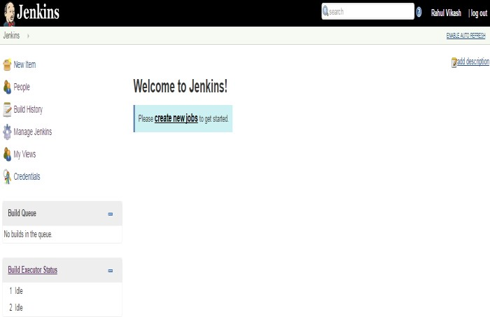
Test Automation & Advanced Selenium
WebDriver Test with XUnit
Creating Job in Jenkins
Jenkins Installation
By default, Jenkins will run on the 8080 port. To specify the port manually, use the -
-httpPort option:
java -jar jenkins.war --httpPort=8081

Slide 15
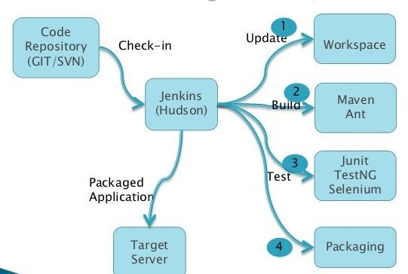
Test Automation & Advanced Selenium
WebDriver Test with XUnit
Creating Job in Jenkins
Git, Maven with Jenkins
Integration Git repository with Jenkins & Build using Maven
By default, Jenkins will run on the 8080 port. To specify the port manually, use the -
-httpPort option:
java -jar jenkins.war --httpPort=8081

Slide 16
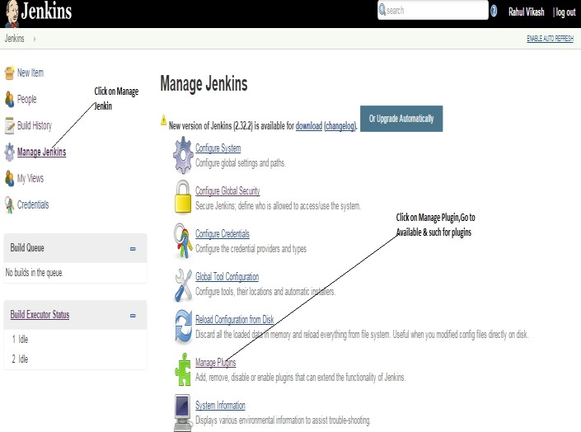
Test Automation & Advanced Selenium
WebDriver Test with XUnit
Adding plugin in Jenkins
Manage plugins
By default, Jenkins will run on the 8080 port. To specify the port manually, use the -
-httpPort option:
java -jar jenkins.war --httpPort=8081

Slide 17
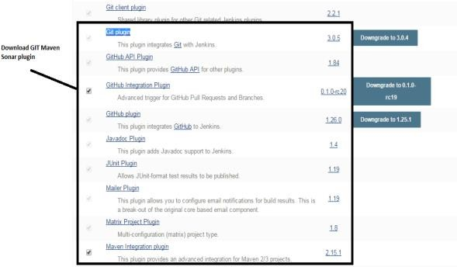
Test Automation & Advanced Selenium
WebDriver Test with XUnit
Adding plugin in Jenkins
Manage plugins
Download Maven ,Git plugin
By default, Jenkins will run on the 8080 port. To specify the port manually, use the -
-httpPort option:
java -jar jenkins.war --httpPort=8081

Slide 18
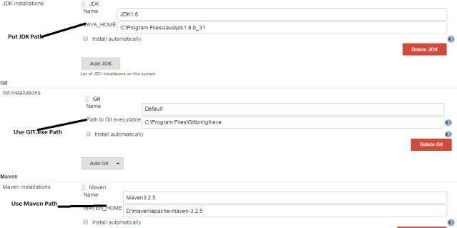
Test Automation & Advanced Selenium
WebDriver Test with XUnit
Adding plugin in Jenkins
Manage plugins
Setting Configuration
Go to Manage Jenkin->Global Tools Configuration
By default, Jenkins will run on the 8080 port. To specify the port manually, use the -
-httpPort option:
java -jar jenkins.war --httpPort=8081

Slide 19
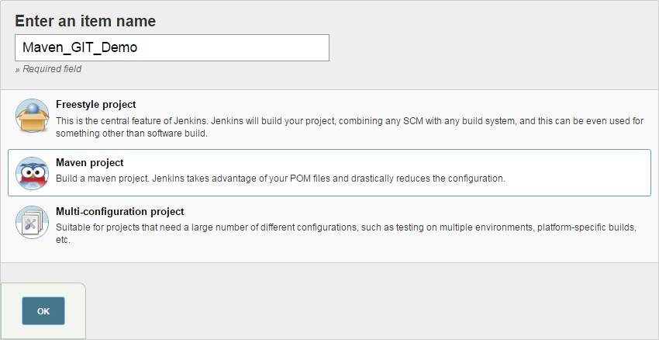
Test Automation & Advanced Selenium
WebDriver Test with XUnit
Creating Job with Maven & Git
Creating Maven Project
Create a Job, Give Job Name ,Select Maven Project & press Ok
By default, Jenkins will run on the 8080 port. To specify the port manually, use the -
-httpPort option:
java -jar jenkins.war --httpPort=8081

Slide 20
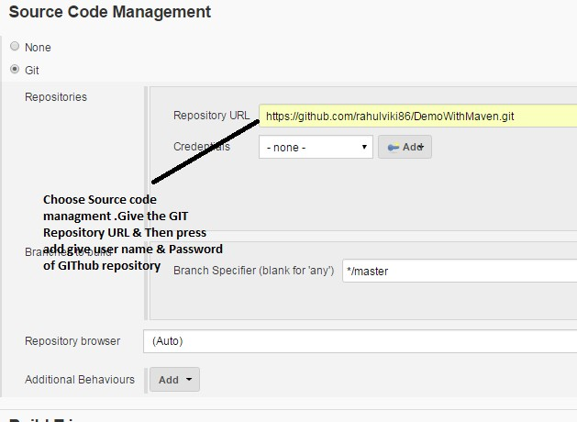
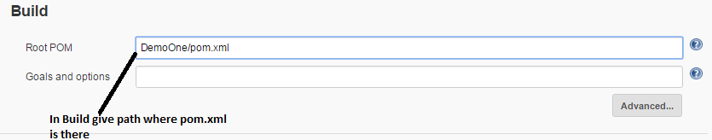
Test Automation & Advanced Selenium
WebDriver Test with XUnit
Creating Job with Maven & Git
Creating Maven Project
Integra pom.x
ting Git with Jenkins by giving repository url(GitHub URL) & path of
ml in project
By default, Jenkins will run on the 8080 port. To specify the port manually, use the -
-httpPort option:
java -jar jenkins.war --httpPort=8081

Slide 21
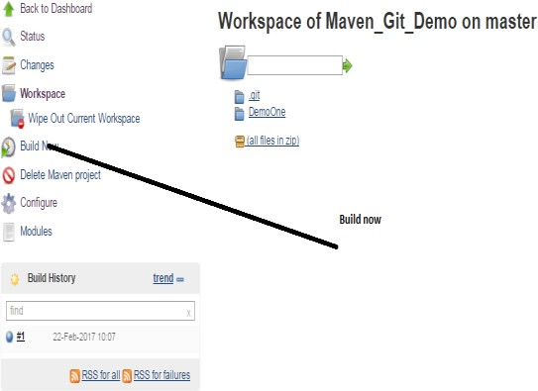
Test Automation & Advanced Selenium
WebDriver Test with XUnit
Creating Job with Maven & Git
Creating Maven Project
Save & check in workspace all data fetched from Git Repository & then build
By default, Jenkins will run on the 8080 port. To specify the port manually, use the -
-httpPort option:
java -jar jenkins.war --httpPort=8081

Slide 22
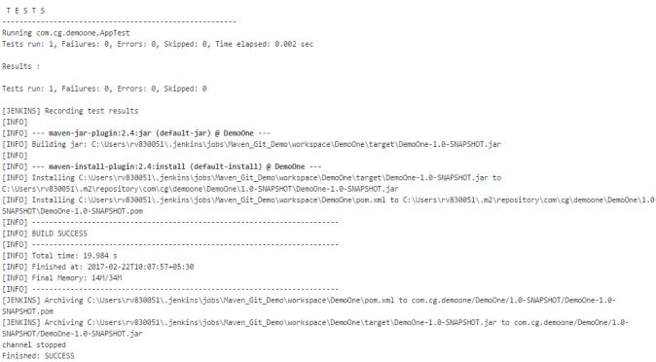
Test Automation & Advanced Selenium
WebDriver Test with XUnit
Creating Job with Maven & Git
Creating Maven Project
By default, Jenkins will run on the 8080 port. To specify the port manually, use the -
-httpPort option:
java -jar jenkins.war --httpPort=8081

Slide 23
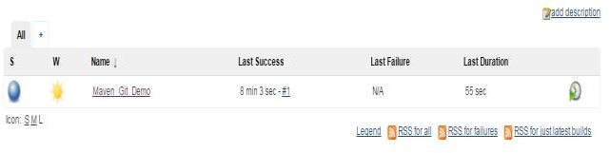
Test Automation & Advanced Selenium
WebDriver Test with XUnit
Creating Job with Maven & Git
Creating Maven Project
Check & get all feedback when it changes
Build result obtained from the dashboard
By default, Jenkins will run on the 8080 port. To specify the port manually, use the -
-httpPort option:
java -jar jenkins.war --httpPort=8081

Slide 24
Test Automation & Advanced Selenium
WebDriver Test with XUnit
Add instructor notes
Demo
Demo on Maven-Git-Jenkins integration
here.
Add the notes here.

Slide 25
Test Automation & Advanced Selenium
WebDriver Test with XUnit
Add instructor notes
Lab
Lab 03
here.
Add the notes here.

Slide 26

Test Automation & Advanced Selenium
WebDriver Test with XUnit
Summary
In this lesson, you have learnt
Jenkins Introduction
Creating Configuring and Running Jenkins Jobs
Adding plugin in Jenkins
Creating Job with Maven & Git
lacks documentation
Add the notes here.

Slide 27

Test Automation & Advanced Selenium
WebDriver Test with XUnit
Review Question
Which of the given statement is not correct for Continuous Integrations?
Continuous Integration is about reducing the risk by providing faster feedback.
Continuous Integration involves a tool that monitors version control system for changes.
Continuous Integration provides solutions to the testers for the failed test cases.
Continuous Integration helps End user to the testers and the end users faster, more reliably, and with less efforts.
Which command execution will start Jenkins as a standalone application?
jenkins.war
java -jar jenkins.war
is the process of deploying the latest code into production.
Build job
Continuous Deployment
Continuous Testing
None of the above

